Slide 1

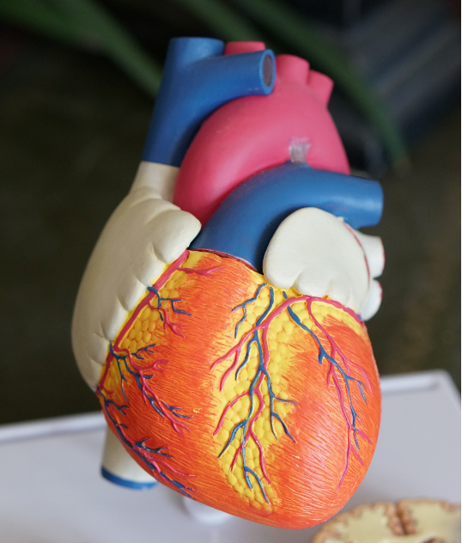
Predicting Heart Disease
Using Machine Learning methods

Slide 2

Hypothesis: Can I predict Heart Disease using a predefined dataset with Machine Learning
Logistic Regression &
Random Forest Methods

Slide 3


Hypothesis
Can we predict Heart Disease from the Cleveland Dataset
Heart Disease original site. Data based on the Cleveland Data Set.
It is made up of 14 columns.
-age in years
-gender (1 is Male; 0 is Female)
-cp = chest pain type. Ranges from 1 to 3
-trestbps = resting blood pressure in hg on admission to hospital
-chol =serum cholestral in mg/dl
-fbs = fasting blood sugar & gt
-restecg = resting electrographic results
-thalach = maximum heart rate achieved
-exang = exercise induced angina (1 = yes, 0 = no)
-oldpeak = st depression induced by exercise relative to rest
-slope = the slope of the peak exercise ST segment
-ca = number of major vessels (0-3) colored by flourosopy
-thai (3 = normal; 6 = fixed defect; 7 = reversable defect)
-condition (1 = heart disease or o = no heart disease)
Heart Disease
Kaggle Data Set
UCI Machine Learning Repository: Heart Disease Data Set
Heart Disease Cleveland UCI | Kaggle
Heart Disease original site. Data based on the Cleveland Data Set.
It is made up of 14 columns.

Slide 4
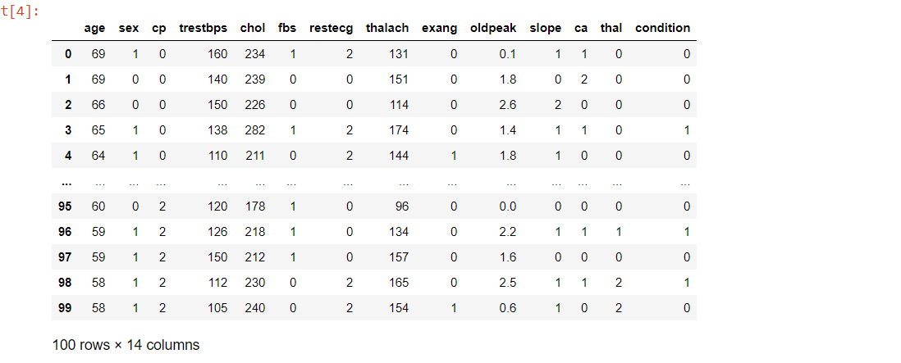
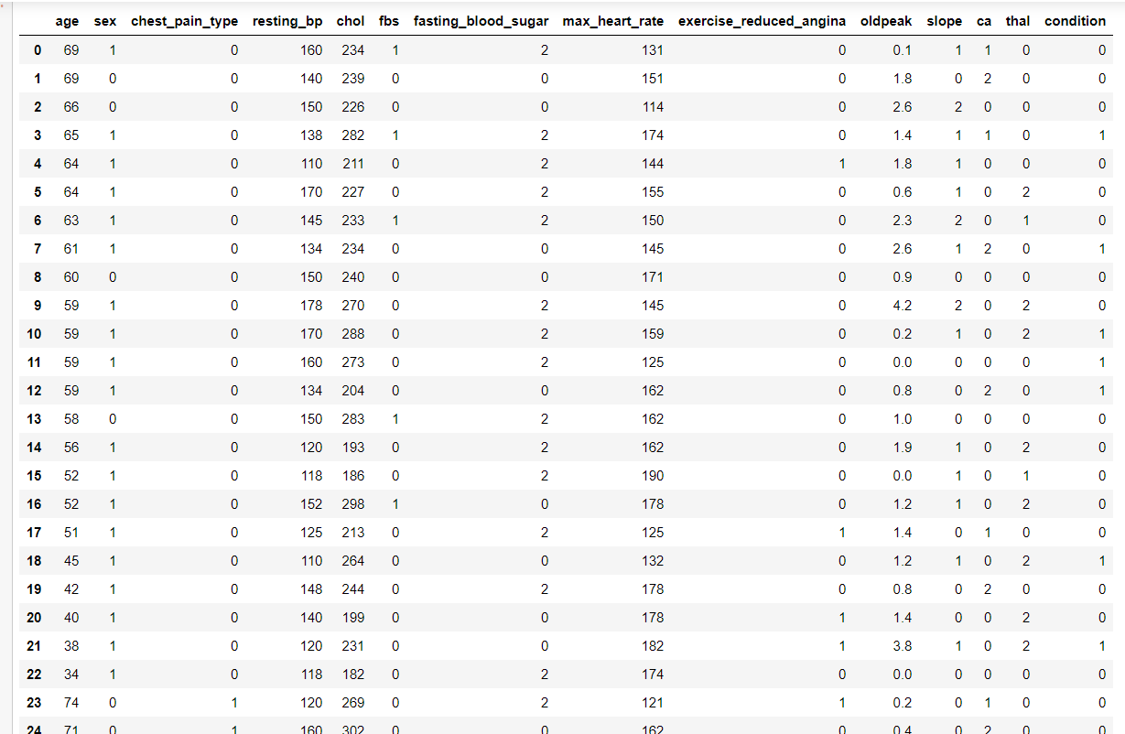


Explorationary Data Analysis (EDA)
.
Looked at the dataset to see what it looked like
Renamed columns – so easier to read
Data set has 298 rows of data.

Slide 5
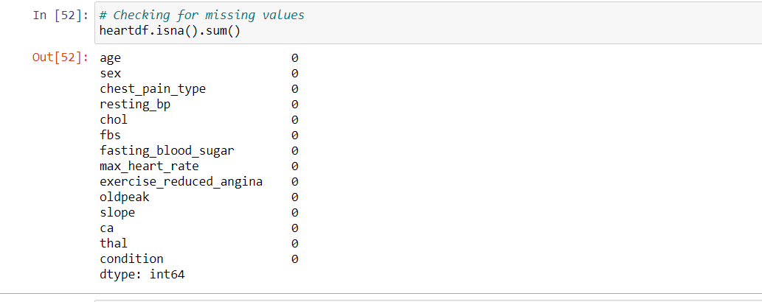
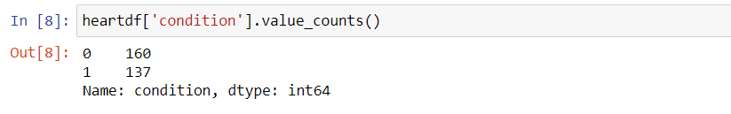
Exploratory Data Analysis (continued)
Checking for Missing Values
Checking for number of Values with the condition – Heart Disease or no Heart Disease.

Slide 6
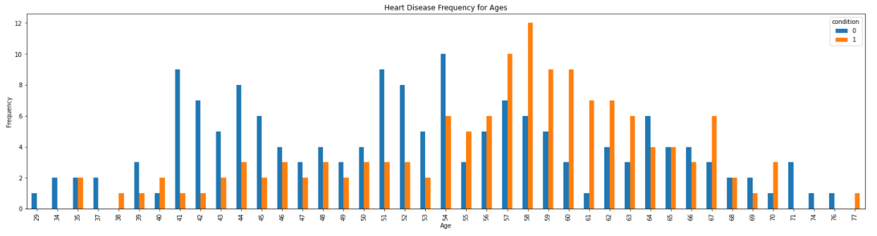
Exploratory Data Analysis (continued)
Dataset of Ages vs Heart Disease (1) /No Disease (0)shows the distribution of the Dataset
Blue - No Heart Disease would appear to prevalent in the early 40 to mid 40s and also early 50’s – according to this dataset.
Orange - Heart Disease more prevalent in the mid to late 50’s in this dataset.

Slide 7
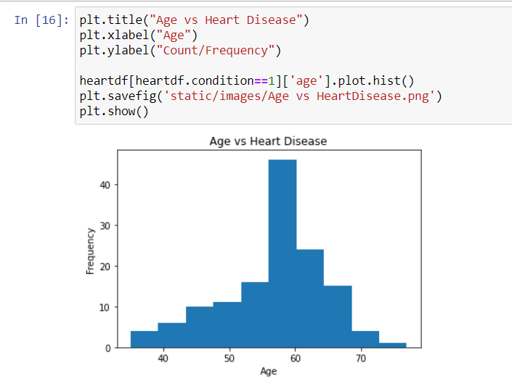
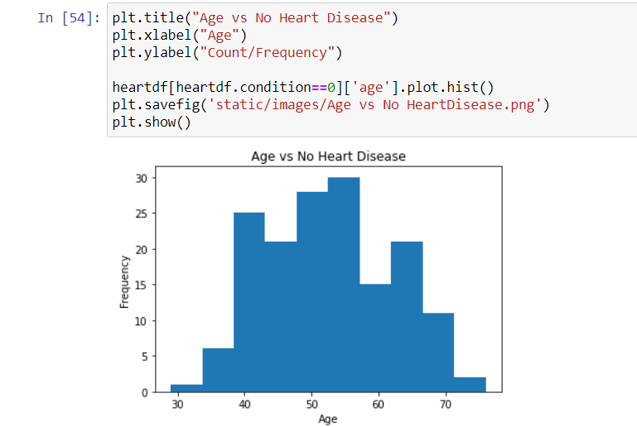
Histograms of Dataset to determine if Normal distribution
Both Datasets seem quite normal with no unusual outliners.

Slide 8
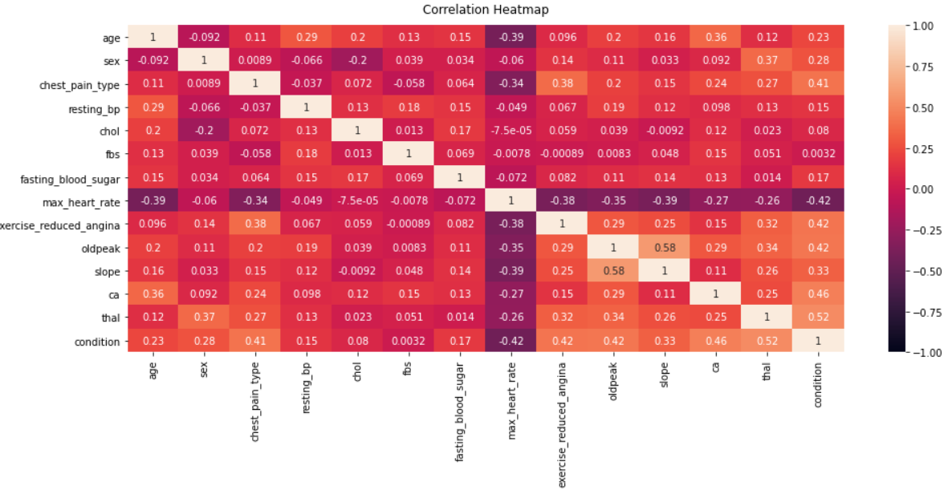
Heatmap - any correlation between features
No correlation greater than 0.5 apart from thal.
Age, cholesterol, resting_bp, maximum heart_rate.

Slide 9
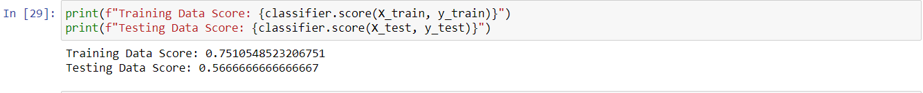
1st Machine Learning method – Logistic Regression
….”Logistic regression is essentially used to calculate (or predict) the probability of a binary (yes/no) event occurring.” Source: What is Logistic Regression? A Beginner's Guide (careerfoundry.com) So, Heart Disease yes or no? Classification methodology
#Features are age, resting_bp, cholesterol and maximum heart rate
Low testing score of 56%. So decided to add a new feature.

Slide 10
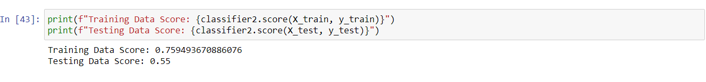
Machine Learning method 2nd Method – Logistic Regression
#Features are age, sex, resting_bp, cholesterol and maximum heart rate
Lower testing score of 55%. Decided to use a different methodology.

Slide 11
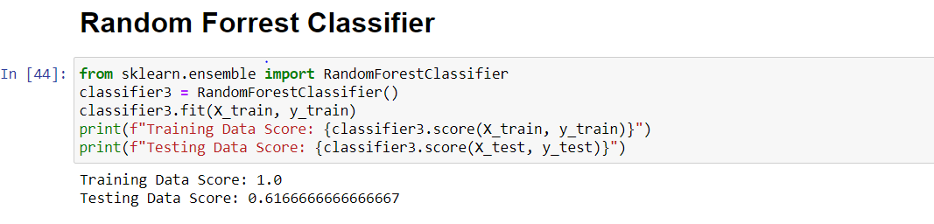
Machine Learning method 3rd attempt – Random Forrest Classifier
“It is a very popular classification algorithm. One of the most interesting thing about this algorithm is that it can be used as both classification and random forest regression algorithm. The RF algorithm is an algorithm for machine learning, which is a forest. We know the forest consists of a number of trees. The trees being mentioned here are decision trees. Therefore, the RF algorithm comprises a random collection or a random selection of a forest tree. It is an addition to the decision tree algorithm. So basically, what a RF algorithm does is that it creates a random sample of multiple decision trees and merges them together to obtain a more stable and accurate prediction through cross validation. In general, the more trees in the forest, the more robust would be the prediction and thus higher accuracy.” Source: Random Forest Analysis in ML and when to use it - NewGenApps
Higher testing score of 61%. Improvement of 5% from original attempt.

Slide 12

Team
Gail McGlinn
Data Analyst/Financial Analyst
Senior Financial Partner. 20+ Years Experience using Data to assist Management make better Commercial & Business Improvement Decisions.

Slide 13

Summary
Dataset old and limited number of entries approx. 297 entries. Date of dataset dates back to 1998.
Need to further refine Machine Learning methodologies to get a higher prediction rate. Could try: K-nearest neighbours or Support Vector Machine.
Interesting to look at other Kaggle Heart Disease predictions as some have higher prediction rates. They used the original Kaggle Dataset heart.csv whereas I used the reprocessed Cleveland heart disease data. Perhaps should of stuck to the original set where I got around 86%.
Predication of Heart Disease – how effective?

